Slide 1
Final Review Discussion Session

Slide 2
Schedule
E-R Diagrams
Functional Dependency & Normal Forms
Transactions
Concurrency Control
Recovery
Note that we only have limited time so some contents are left in extra slides, also please check the lecture notes for other missing contents.

Slide 3
E-R Diagrams

Slide 4
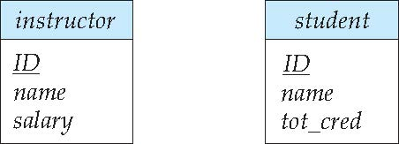
Entity Sets
Entities can be represented graphically as follows:
Rectangles represent entity sets.
Attributes listed inside entity rectangle
Underline indicates primary key attributes

Slide 5
Relationship Sets
Diamonds represent relationship sets.

Slide 6
Relationship Sets with Attributes

Slide 7
Roles
Entity sets of a relationship need not be distinct
Each occurrence of an entity set plays a “role” in the relationship
The labels “course_id” and “prereq_id” are called roles.

Slide 8
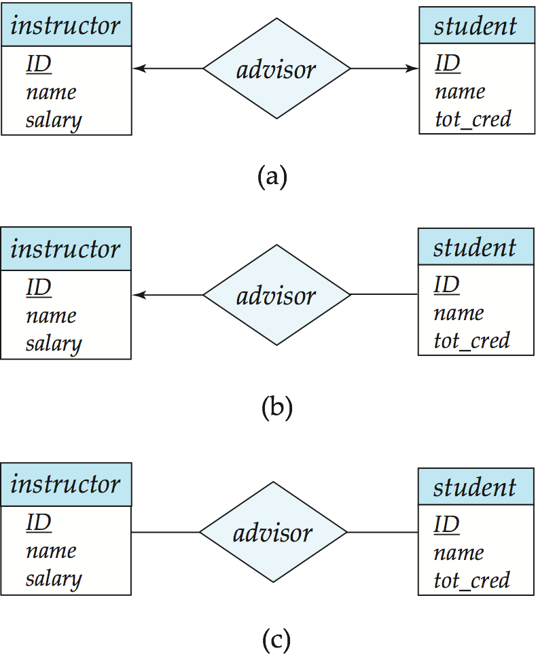
Cardinality Constraints
We express cardinality constraints by drawing either a directed line (→), signifying “one,” or an undirected line (—), signifying “many,” between the relationship set and the entity set.
One-to-one relationship between an instructor and a student :
A student is associated with at most one instructor via the relationship advisor
A student is associated with at most one department via stud_dept

Slide 9
One-to-Many Relationship
one-to-many relationship between an instructor and a student
an instructor is associated with several (including 0) students via advisor
a student is associated with at most one instructor via advisor,

Slide 10
Many-to-One Relationships
In a many-to-one relationship between an instructor and a student,
an instructor is associated with at most one student via advisor,
and a student is associated with several (including 0) instructors via advisor

Slide 11
Many-to-Many Relationship
An instructor is associated with several (possibly 0) students via advisor
A student is associated with several (possibly 0) instructors via advisor

Slide 12
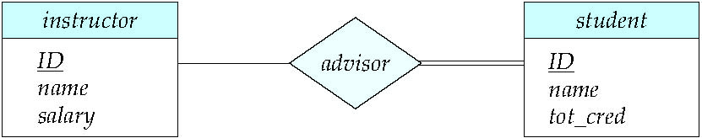
Total and Partial Participation
Total participation (indicated by double line): every entity in the entity set participates in at least one relationship in the relationship set
participation of student in advisor relation is total
every student must have an associated instructor
Partial participation: some entities may not participate in any relationship in the relationship set
Example: participation of instructor in advisor is partial

Slide 13
Notation for Expressing More Complex Constraints
A line may have an associated minimum and maximum cardinality, shown in the form l..h, where l is the minimum and h the maximum cardinality
A minimum value of 1 indicates total participation.
A maximum value of 1 indicates that the entity participates in at most one relationship
A maximum value of * indicates no limit.
Instructor can advise 0 or more students. A student must have 1 advisor; cannot have multiple advisors

Slide 14
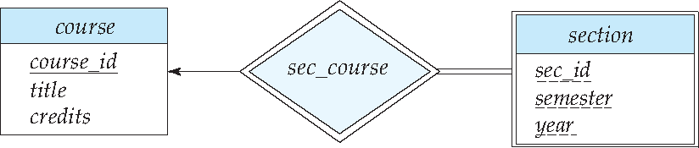
Expressing Weak Entity Sets
In E-R diagrams, a weak entity set is depicted via a double rectangle.
We underline the discriminator of a weak entity set with a dashed line.
The relationship set connecting the weak entity set to the identifying strong entity set is depicted by a double diamond.
Primary key for section – (course_id, sec_id, semester, year)

Slide 15
Review by yourself
Reduction to Relation Schemas
These are also important concepts and may be tested in the final, but we have run out of time thus skip them. (In Extra Slides)

Slide 16
Normal Forms

Slide 17
Functional Dependencies (Cont.)
Let R be a relation schema
α ⊆ R and β ⊆ R
The functional dependency
α → β holds on R if and only if for any legal relations r(R), whenever any two tuples t₁ and t₂ of r agree on the attributes α, they also agree on the attributes β. That is,
t₁[α] = t₂ [α] ⇒ t₁[β ] = t₂ [β ]
Example: Consider r(A,B ) with the following instance of r.
On this instance, A → B does NOT hold, but B → A does hold.
4
1 5
3 7

Slide 18
Functional Dependencies (Cont.)
K is a superkey for relation schema R if and only if K → R
K is a candidate key for R if and only if
K → R, and
for no α ⊂ K, α → R
Functional dependencies allow us to express constraints that cannot be expressed using superkeys. Consider the schema:
inst_dept (ID, name, salary, dept_name, building, budget ).
We expect these functional dependencies to hold:
dept_name→ building
and ID → building
but would not expect the following to hold:
dept_name → salary

Slide 19
Functional Dependencies (Cont.)
A functional dependency is trivial if it is satisfied by all instances of a relation
Example:
ID, name → ID
name → name
In general, α → β is trivial if β ⊆ α

Slide 20
Boyce-Codd Normal Form
A relation schema R is in BCNF with respect to a set F of functional dependencies if for all functional dependencies in F⁺ of the form
α → β
where α ⊆ R and β ⊆ R, at least one of the following holds:
α  → β is trivial (i.e., β ⊆ α)
α is a superkey for R
Example schema not in BCNF:
instr_dept (ID, name, salary, dept_name, building, budget )
because dept_name→ building, budget
holds on instr_dept, but dept_name is not a superkey

Slide 21
Decomposing a Schema into BCNF
Suppose we have a schema R and a non-trivial dependency α →β causes a violation of BCNF.
We decompose R into:
(α U β )
( R - ( β - α ) )
In our example,
α = dept_name
β = building, budget
and inst_dept is replaced by
(α U β ) = ( dept_name, building, budget )
( R - ( β - α ) ) = ( ID, name, salary, dept_name )

Slide 22
Third Normal Form
A relation schema R is in third normal form (3NF) if for all:
α → β in F⁺ at least one of the following holds:
α → β is trivial (i.e., β ∈ α)
α is a superkey for R
Each attribute A in β – α is contained in a candidate key for R.
(NOTE: each attribute may be in a different candidate key)
If a relation is in BCNF it is in 3NF (since in BCNF one of the first two conditions above must hold).
Third condition is a minimal relaxation of BCNF to ensure dependency preservation (will see why later).

Slide 23
3NF Example
Relation dept_advisor:
dept_advisor (s_ID, i_ID, dept_name) F = {s_ID, dept_name → i_ID, i_ID → dept_name}
Two candidate keys: s_ID, dept_name, and i_ID, s_ID
R is in 3NF
s_ID, dept_name → i_ID s_ID
dept_name is a superkey
i_ID → dept_name
dept_name is contained in a candidate key

Slide 24
Lossless-join Decomposition
For the case of R = (R₁, R₂), we require that for all possible relations r on schema R
r = ∏_{R1} (r ) ∏_{R2} (r )
In other words, the decomposed relations can be joined to form the original table exactly
A decomposition of R into R₁ and R₂ is lossless join if at least one of the following dependencies is in F⁺:
R₁ ∩ R₂ → R₁
R₁ ∩ R₂ → R₂
The above functional dependencies are a sufficient condition for lossless join decomposition; the dependencies are a necessary condition only if all constraints are functional dependencies

Slide 25
Dependency Preservation
Let F_{i} be the set of dependencies F ⁺ that include only attributes in R_{i}.
A decomposition is dependency preserving, if
(F₁ ∪ F₂ ∪ … ∪ F_{n} )⁺ = F ⁺
If it is not, then checking updates for violation of functional dependencies may require computing joins, which is expensive.
Lossless Decomposition vs Functional Dependency Preservation
Not the same concept!
Check Piazza @291

Slide 26
Example
R = (A, B, C) F = {A → B, B → C)
Can be decomposed in two different ways
R₁ = (A, B), R₂ = (B, C)
Lossless-join decomposition:
R₁ ∩ R₂ = {B} and B → BC
Dependency preserving
R₁ = (A, B), R₂ = (A, C)
Lossless-join decomposition:
R₁ ∩ R₂ = {A} and A → AB
Not dependency preserving (cannot check B → C without computing R₁ join R₂)

Slide 27
Testing for BCNF
To check if a non-trivial dependency α →β causes a violation of BCNF
1. compute α⁺ (the attribute closure of α), and
2. verify that it includes all attributes of R, that is, it is a superkey of R.
Simplified test: To check if a relation schema R is in BCNF, it suffices to check only the dependencies in the given set F for violation of BCNF, rather than checking all dependencies in F⁺.
If none of the dependencies in F causes a violation of BCNF, then none of the dependencies in F⁺ will cause a violation of BCNF either.
However, simplified test using only F is incorrect when testing a relation in a decomposition of R
Consider R = (A, B, C, D, E), with F = { A → B, BC → D}
Decompose R into R₁ = (A,B) and R₂ = (A,C,D, E)
Neither of the dependencies in F contain only attributes from (A,C,D,E) so we might be mislead into thinking R₂ satisfies BCNF.
In fact, dependency AC → D in F⁺ shows R₂ is not in BCNF.

Slide 28
Testing Decomposition for BCNF
To check if a relation R_{i} in a decomposition of R is in BCNF,
Either test R_{i} for BCNF with respect to the restriction of F to R_{i} (that is, all FDs in F⁺ that contain only attributes from R_{i})
or use the original set of dependencies F that hold on R, but with the following test:
for every set of attributes α ⊆ R_{i}, check that α⁺ (the attribute closure of α) either includes no attribute of R_{i}- α, or includes all attributes of R_{i}.
If the condition is violated by some α → β in F, the dependency α → (α⁺ - α ) ∩ R_{i} can be shown to hold on R_{i}, and R_{i} violates BCNF.
We use above dependency to decompose R_{i}

Slide 29
BCNF Decomposition Algorithm
result := {R }; done := false; compute F ⁺; while (not done) do if (there is a schema R_{i} in result that is not in BCNF) then begin let α  → β be a nontrivial functional dependency that holds on R_{i} such that α  → R_{i} is not in F ⁺, and α ∩ β = ∅; result := (result – R_{i} ) ∪ (R_{i} – β) ∪ (α, β ); end else done := true;
Note: each R_{i} is in BCNF, and decomposition is lossless-join.

Slide 30
Transactions

Slide 31
Transaction Concept
A transaction is a unit of program execution that accesses and possibly updates various data items.
E.g., transaction to transfer $50 from account A to account B:
1. read(A)
2. A := A – 50
3. write(A)
4. read(B)
5. B := B + 50
6. write(B)
Two main issues to deal with:
Failures of various kinds, such as hardware failures and system crashes
Concurrent execution of multiple transactions

Slide 32
ACID Properties
A transaction is a unit of program execution that accesses and possibly updates various data items. To preserve the integrity of data the database system must ensure:
Atomicity. Either all operations of the transaction are properly reflected in the database or none are.
Consistency. Execution of a transaction in isolation preserves the consistency of the database.
Isolation. Although multiple transactions may execute concurrently, each transaction must be unaware of other concurrently executing transactions. Intermediate transaction results must be hidden from other concurrently executed transactions.
That is, for every pair of transactions T_{i} and T_{j}, it appears to T_{i} that either T_{j}, finished execution before T_{i} started, or T_{j} started execution after T_{i} finished.
Durability. After a transaction completes successfully, the changes it has made to the database persist, even if there are system failures.

Slide 33
Schedules
Schedule – a sequences of instructions that specify the chronological order in which instructions of concurrent transactions are executed
A schedule for a set of transactions must consist of all instructions of those transactions
Must preserve the order in which the instructions appear in each individual transaction.
A transaction that successfully completes its execution will have a commit instructions as the last statement
By default transaction assumed to execute commit instruction as its last step
A transaction that fails to successfully complete its execution will have an abort instruction as the last statement

Slide 34
Serializability
Basic Assumption – Each transaction preserves database consistency.
Thus, serial execution of a set of transactions preserves database consistency.
A (possibly concurrent) schedule is serializable if it is equivalent to a serial schedule. Different forms of schedule equivalence give rise to the notions of:
1. conflict serializability
2. view serializability

Slide 35
Conflicting Instructions
Let l_{i} and l_{j} be two Instructions of transactions T_{i} and T_{j} respectively. Instructions l_{i} and l_{j} conflict if and only if there exists some item Q accessed by both l_{i} and l_{j}, and at least one of these instructions wrote Q.
1. l_{i} = read(Q), l_{j} = read(Q). l_{i} and l_{j} don’t conflict. 2. l_{i} = read(Q), l_{j} = write(Q). They conflict. 3. l_{i} = write(Q), l_{j} = read(Q). They conflict 4. l_{i} = write(Q), l_{j} = write(Q). They conflict
Intuitively, a conflict between l_{i} and l_{j} forces a (logical) temporal order between them.
If l_{i} and l_{j} are consecutive in a schedule and they do not conflict, their results would remain the same even if they had been interchanged in the schedule.

Slide 36
Conflict Serializability
If a schedule S can be transformed into a schedule S´ by a series of swaps of non-conflicting instructions, we say that S and S´ are conflict equivalent.
We say that a schedule S is conflict serializable if it is conflict equivalent to a serial schedule

Slide 37
Precedence Graph
Consider some schedule of a set of transactions T₁, T₂, ..., T_{n}
Precedence graph — a direct graph where the vertices are the transactions (names).
We draw an arc from T_{i} to T_{j} if the two transaction conflict, and T_{i} accessed the data item on which the conflict arose earlier.
A schedule is conflict serializable if and only if its precedence graph is acyclic.
Example

Slide 38
Recoverable Schedules
Recoverable schedule — if a transaction T_{j} reads a data item previously written by a transaction T_{i} , then the commit operation of T_{i} must appear before the commit operation of T_{j}.
The following schedule is not recoverable if T₉ commits immediately after the read(A) operation.
If T₈ should abort, T₉ would have read (and possibly shown to the user) an inconsistent database state. Hence, database must ensure that schedules are recoverable.

Slide 39
Cascading Rollbacks
Cascading rollback – a single transaction failure leads to a series of transaction rollbacks. Consider the following schedule where none of the transactions has yet committed (so the schedule is recoverable) If T₁₀ fails, T₁₁ and T₁₂ must also be rolled back.
Can lead to the undoing of a significant amount of work

Slide 40
Cascadeless Schedules
Cascadeless schedules — for each pair of transactions T_{i} and T_{j} such that T_{j} reads a data item previously written by T_{i}, the commit operation of T_{i} appears before the read operation of T_{j}.
Every cascadeless schedule is also recoverable
It is desirable to restrict the schedules to those that are cascadeless
Example of a schedule that is NOT cascadeless

Slide 41
Concurrency Control

Slide 42
Concurrency Control
A database must provide a mechanism that will ensure that all possible schedules are both:
Conflict serializable.
Recoverable and preferably cascadeless
A policy in which only one transaction can execute at a time generates serial schedules, but provides a poor degree of concurrency
Concurrency-control schemes tradeoff between the amount of concurrency they allow and the amount of overhead that they incur
Testing a schedule for serializability after it has executed is a little too late!
Tests for serializability help us understand why a concurrency control protocol is correct
Goal – to develop concurrency control protocols that will assure serializability.

Slide 43
Lock-Based Protocols
A lock is a mechanism to control concurrent access to a data item
Data items can be locked in two modes :
1. exclusive (X) mode. Data item can be both read as well as
written. X-lock is requested using lock-X instruction.
2. shared (S) mode. Data item can only be read. S-lock is
requested using lock-S instruction.
Lock requests are made to the concurrency-control manager by the programmer. Transaction can proceed only after request is granted.

Slide 44
Lock-Based Protocols (Cont.)
Lock-compatibility matrix
A transaction may be granted a lock on an item if the requested lock is compatible with locks already held on the item by other transactions
Any number of transactions can hold shared locks on an item,
But if any transaction holds an exclusive on the item no other transaction may hold any lock on the item.
If a lock cannot be granted, the requesting transaction is made to wait till all incompatible locks held by other transactions have been released. The lock is then granted.

Slide 45
Lock-Based Protocols (Cont.)
Example of a transaction performing locking:
T₂: lock-S(A);
read (A);
unlock(A);
lock-S(B);
read (B);
unlock(B);
display(A+B)
Locking as above is not sufficient to guarantee serializability — if A and B get updated in-between the read of A and B, the displayed sum would be wrong.
A locking protocol is a set of rules followed by all transactions while requesting and releasing locks. Locking protocols restrict the set of possible schedules.

Slide 46
The Two-Phase Locking Protocol
This protocol ensures conflict-serializable schedules.
Phase 1: Growing Phase
Transaction may obtain locks
Transaction may not release locks
Phase 2: Shrinking Phase
Transaction may release locks
Transaction may not obtain locks
The protocol assures serializability. It can be proved that the transactions can be serialized in the order of their lock points (i.e., the point where a transaction acquired its final lock).

Slide 47
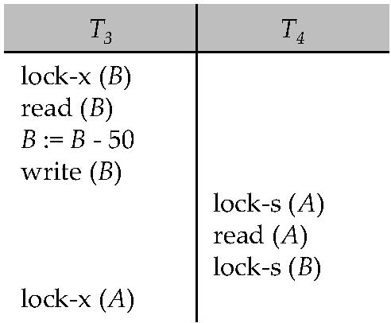
Deadlocks
Consider the partial schedule
Neither T₃ nor T₄ can make progress — executing lock-S(B) causes T₄ to wait for T₃ to release its lock on B, while executing lock-X(A) causes T₃ to wait for T₄ to release its lock on A.
Such a situation is called a deadlock.
To handle a deadlock one of T₃ or T₄ must be rolled back and its locks released.

Slide 48
Deadlocks (Cont.)
Two-phase locking does not ensure freedom from deadlocks.
In addition to deadlocks, there is a possibility of starvation.
Starvation occurs if the concurrency control manager is badly designed. For example:
A transaction may be waiting for an X-lock on an item, while a sequence of other transactions request and are granted an S-lock on the same item.
The same transaction is repeatedly rolled back due to deadlocks.
Concurrency control manager can be designed to prevent starvation.

Slide 49
Deadlocks (Cont.)
The potential for deadlock exists in most locking protocols. Deadlocks are a necessary evil.
When a deadlock occurs there is a possibility of cascading roll-backs.
Cascading roll-back is possible under two-phase locking. To avoid this, follow a modified protocol called strict two-phase locking -- a transaction must hold all its exclusive locks till it commits/aborts.
Rigorous two-phase locking is even stricter. Here, all locks are held till commit/abort. In this protocol transactions can be serialized in the order in which they commit.

Slide 50
Deadlock Handling
System is deadlocked if there is a set of transactions such that every transaction in the set is waiting for another transaction in the set.
Deadlock prevention protocols ensure that the system will never enter into a deadlock state. Some prevention strategies :
Require that each transaction locks all its data items before it begins execution (predeclaration).
Impose partial ordering of all data items and require that a transaction can lock data items only in the order specified by the partial order.

Slide 51
More Deadlock Prevention Strategies
Following schemes use transaction timestamps for the sake of deadlock prevention alone.
wait-die scheme — non-preemptive
older transaction may wait for younger one to release data item. (older means smaller timestamp) Younger transactions never Younger transactions never wait for older ones; they are rolled back instead.
a transaction may die several times before acquiring needed data item
wound-wait scheme — preemptive
older transaction wounds (forces rollback) of younger transaction instead of waiting for it. Younger transactions may wait for older ones.
may be fewer rollbacks than wait-die scheme.

Slide 52
Review by yourself
Deadlock Detection
Deadlock Recovery
Timestamp-Based Protocols
These are also important concepts and may be tested in the final, but we have run out of time thus skip them. (In Extra Slides)

Slide 53
Recovery

Slide 54
Log-Based Recovery
A log is kept on stable storage.
The log is a sequence of log records, and maintains a record of update activities on the database.
When transaction T_{i} starts, it registers itself by writing a <T_{i} start>log record
Before T_{i} executes write(X), a log record <T_{i}, X, V₁, V₂> is written, where V₁ is the value of X before the write (the old value), and V₂ is the value to be written to X (the new value).
When T_{i} finishes it last statement, the log record <T_{i} commit> is written.
Two approaches using logs
Deferred database modification
Immediate database modification

Slide 55
Immediate Database Modification
The immediate-modification scheme allows updates of an uncommitted transaction to be made to the buffer, or the disk itself, before the transaction commits
Update log record must be written before database item is written
We assume that the log record is output directly to stable storage
Output of updated blocks to stable storage can take place at any time before or after transaction commit
Order in which blocks are output can be different from the order in which they are written.
The deferred-modification scheme performs updates to buffer/disk only at the time of transaction commit
Simplifies some aspects of recovery
But has overhead of storing local copy

Slide 56
Transaction Commit
A transaction is said to have committed when its commit log record is output to stable storage
all previous log records of the transaction must have been output already
Writes performed by a transaction may still be in the buffer when the transaction commits, and may be output later

Slide 57
Immediate Database Modification Example
B_{C} output before T₁ commits
B_{A} output after T₀ commits
Log Write Output
<T₀ start>
<T₀, A, 1000, 950>
<T_{o}, B, 2000, 2050
A = 950
B = 2050
<T₀ commit>
<T₁ start>
<T₁, C, 700, 600>
C = 600
B_{B} , B_{C}
<T₁ commit>
B_{A}
Note: B_{X} denotes block containing X.

Slide 58
Undo and Redo Operations
Undo of a log record <T_{i}, X, V₁, V₂> writes the old value V₁ to X
Redo of a log record <T_{i}, X, V₁, V₂> writes the new value V₂ to X
Undo and Redo of Transactions
undo(T_{i}) restores the value of all data items updated by T_{i} to their old values, going backwards from the last log record for T_{i}
each time a data item X is restored to its old value V a special log record <T_{i} , X, V> is written out
when undo of a transaction is complete, a log record <T_{i} abort> is written out.
redo(T_{i}) sets the value of all data items updated by T_{i} to the new values, going forward from the first log record for T_{i}
No logging is done in this case

Slide 59
Undo and Redo on Recovering from Failure
When recovering after failure:
Transaction T_{i} needs to be undone if the log
contains the record <T_{i} start>,
but does not contain either the record <T_{i} commit> or <T_{i} abort>.
Transaction T_{i} needs to be redone if the log
contains the records <T_{i} start>
and contains the record <T_{i} commit> or <T_{i} abort>
Note that If transaction T_{i} was undone earlier and the <T_{i} abort> record written to the log, and then a failure occurs, on recovery from failure T_{i} is redone
such a redo redoes all the original actions including the steps that restored old values
Known as repeating history
Seems wasteful, but simplifies recovery greatly

Slide 60
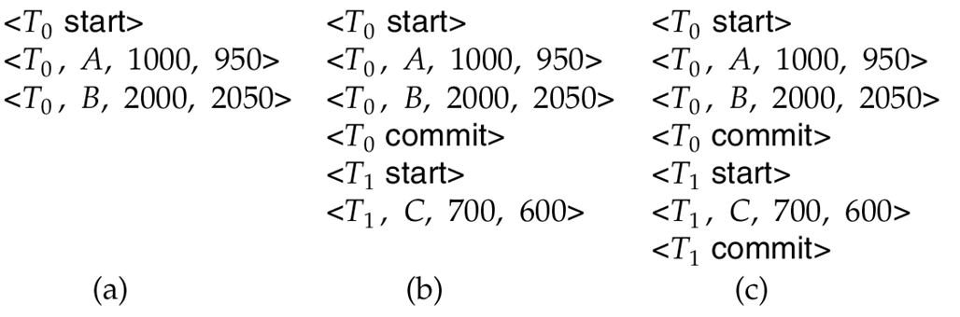
Immediate DB Modification Recovery Example
Below we show the log as it appears at three instances of time.
Recovery actions in each case above are:
(a) undo (T₀): B is restored to 2000 and A to 1000, and log records <T₀, B, 2000>, <T₀, A, 1000>, <T₀, abort> are written out
(b) redo (T₀) and undo (T₁): A and B are set to 950 and 2050 and C is restored to 700. Log records <T₁, C, 700>, <T₁, abort> are written out.
(c) redo (T₀) and redo (T₁): A and B are set to 950 and 2050
respectively. Then C is set to 600

Slide 61
Checkpoints
Redoing/undoing all transactions recorded in the log can be very slow
processing the entire log is time-consuming if the system has run for a long time
we might unnecessarily redo transactions which have already output their updates to the database.
Streamline recovery procedure by periodically performing checkpointing
Output all log records currently residing in main memory onto stable storage.
Output all modified buffer blocks to the disk.
Write a log record < checkpoint L> onto stable storage where L is a list of all transactions active at the time of checkpoint.
All updates are stopped while doing checkpointing

Slide 62
Checkpoints (Cont.)
During recovery we need to consider only the most recent transaction T_{i} that started before the checkpoint, and transactions that started after T_{i}.
Scan backwards from end of log to find the most recent <checkpoint L> record
Only transactions that are in L or started after the checkpoint need to be redone or undone
Transactions that committed or aborted before the checkpoint already have all their updates output to stable storage.
Some earlier part of the log may be needed for undo operations
Continue scanning backwards till a record <T_{i} start> is found for every transaction T_{i} in L.
Parts of log prior to earliest <T_{i} start> record above are not needed for recovery, and can be erased whenever desired.

Slide 63
Example of Checkpoints
T_{c}
T_{f}
T₁ can be ignored (updates already output to disk due to checkpoint)
T₂ and T₃ redone.
T₄ undone
T₁
T₂
T₃
T₄
checkpoint
system failure

Slide 64
Recovery Algorithm
Logging (during normal operation):
<T_{i} start> at transaction start
<T_{i}, X_{j}, V₁, V₂> for each update, and
<T_{i} commit> at transaction end
Transaction rollback (during normal operation)
Let T_{i} be the transaction to be rolled back
Scan log backwards from the end, and for each log record of T_{i} of the form <T_{i}, X_{j}, V₁, V₂>
perform the undo by writing V₁ to X_{j},
write a log record <T_{i} , X_{j}, V₁>
such log records are called compensation log records
Once the record <T_{i} start> is found stop the scan and write the log record <T_{i} abort>

Slide 65
Recovery Algorithm (Cont.)
Recovery from failure: Two phases
Redo phase: replay updates of all transactions, whether they committed, aborted, or are incomplete
Undo phase: undo all incomplete transactions
Redo phase:
Find last <checkpoint L> record, and set undo-list to L.
Scan forward from above <checkpoint L> record
Whenever a record <T_{i}, X_{j}, V₁, V₂> or <T_{i}, X_{j}, V₂> is found, redo it by writing V₂ to X_{j}
Whenever a log record <T_{i} start> is found, add T_{i} to undo-list
Whenever a log record <T_{i} commit> or <T_{i} abort> is found, remove T_{i} from undo-list

Slide 66
Recovery Algorithm (Cont.)
Undo phase:
Scan log backwards from end
Whenever a log record <T_{i}, X_{j}, V₁, V₂> is found where T_{i} is in undo-list perform same actions as for transaction rollback:
perform undo by writing V₁ to X_{j}.
write a log record <T_{i} , X_{j}, V₁>
Whenever a log record <T_{i} start> is found where T_{i} is in undo-list,
Write a log record <T_{i} abort>
Remove T_{i} from undo-list
Stop when undo-list is empty
i.e. <T_{i} start> has been found for every transaction in undo-list
After undo phase completes, normal transaction processing can commence

Slide 67
Example of Recovery

Slide 68
Extra Slides

Slide 69
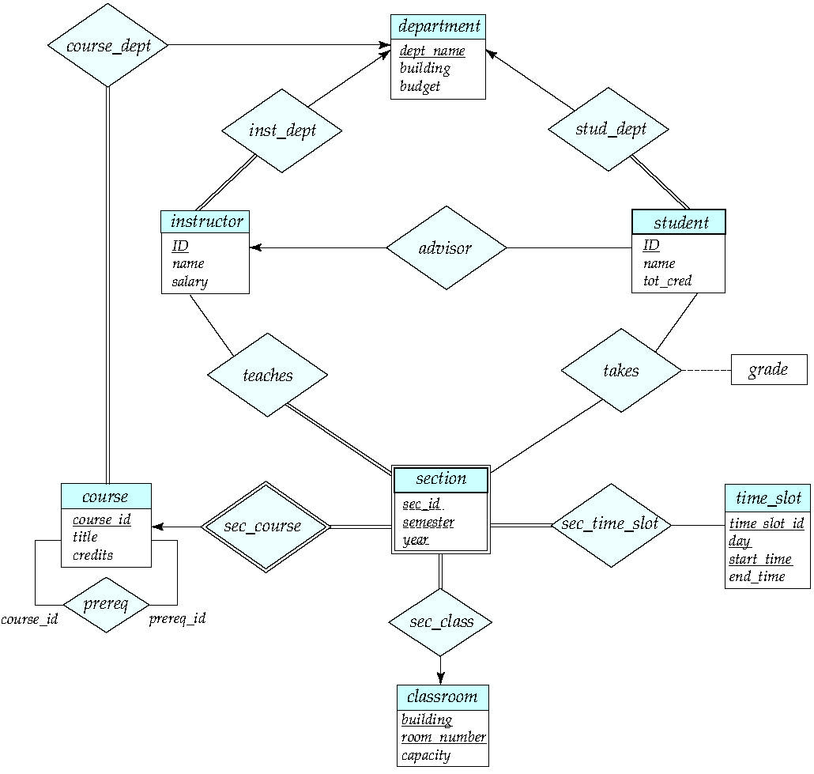
E-R Diagram for a University Enterprise

Slide 70
Reduction to Relation Schemas

Slide 71
Reduction to Relation Schemas
Entity sets and relationship sets can be expressed uniformly as relation schemas that represent the contents of the database.
A database which conforms to an E-R diagram can be represented by a collection of schemas.
For each entity set and relationship set there is a unique schema that is assigned the name of the corresponding entity set or relationship set.
Each schema has a number of columns (generally corresponding to attributes), which have unique names.

Slide 72
Representing Entity Sets
A strong entity set reduces to a schema with the same attributes
student(ID, name, tot_cred)
A weak entity set becomes a table that includes a column for the primary key of the identifying strong entity set
section ( course_id, sec_id, sem, year )

Slide 73
Representing Relationship Sets
A many-to-many relationship set is represented as a schema with attributes for the primary keys of the two participating entity sets, and any descriptive attributes of the relationship set.
Example: schema for relationship set advisor
advisor = (s_id, i_id)

Slide 74
Representation of Entity Sets with Composite Attributes
Composite attributes are flattened out by creating a separate attribute for each component attribute
Example: given entity set instructor with composite attribute name with component attributes first_name and last_name the schema corresponding to the entity set has two attributes name_first_name and name_last_name
Prefix omitted if there is no ambiguity (name_first_name could be first_name)
Ignoring multivalued attributes, extended instructor schema is
instructor(ID, first_name, middle_initial, last_name, street_number, street_name, apt_number, city, state, zip_code, date_of_birth)
Notes:
74

Slide 75
Representation of Entity Sets with Multivalued Attributes
A multivalued attribute M of an entity E is represented by a separate schema EM
Schema EM has attributes corresponding to the primary key of E and an attribute corresponding to multivalued attribute M
Example: Multivalued attribute phone_number of instructor is represented by a schema: inst_phone= ( ID, phone_number)
Each value of the multivalued attribute maps to a separate tuple of the relation on schema EM
For example, an instructor entity with primary key 22222 and phone numbers 456-7890 and 123-4567 maps to two tuples: (22222, 456-7890) and (22222, 123-4567)
Notes:
75

Slide 76
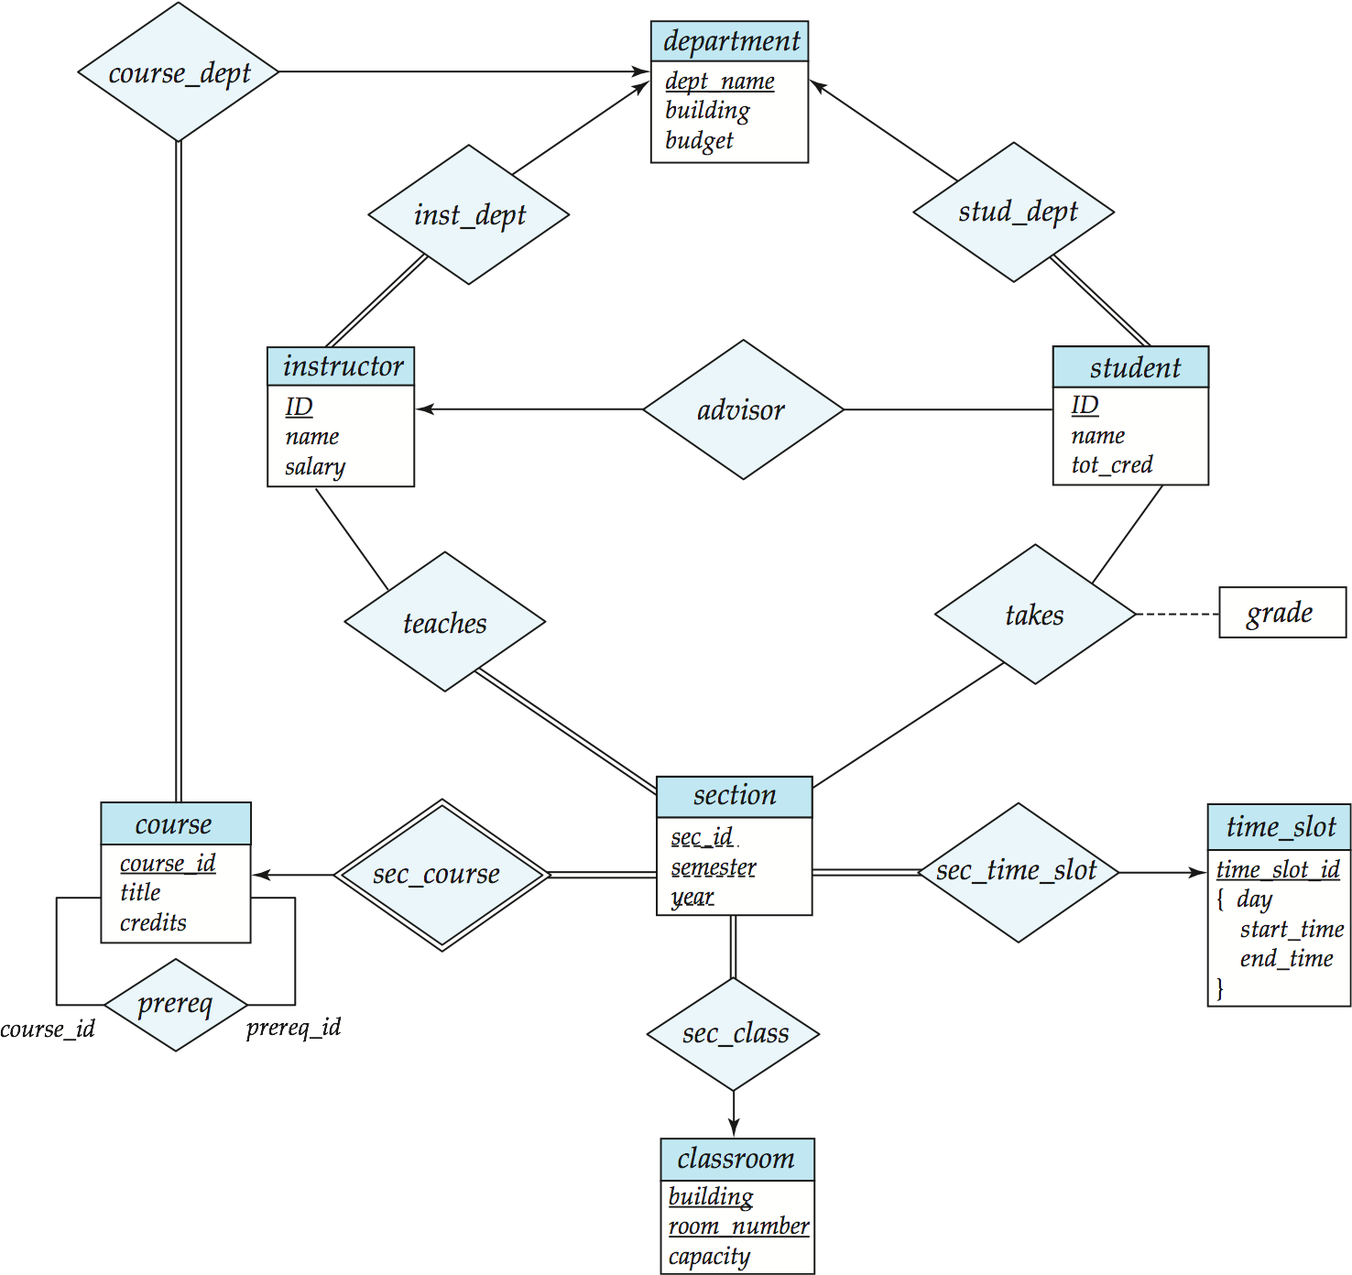
Redundancy of Schemas
Many-to-one and one-to-many relationship sets that are total on the many-side can be represented by adding an extra attribute to the “many” side, containing the primary key of the “one” side
Example: Instead of creating a schema for relationship set inst_dept, add an attribute dept_name to the schema arising from entity set instructor

Slide 77
Redundancy of Schemas (Cont.)
For one-to-one relationship sets, either side can be chosen to act as the “many” side
That is, an extra attribute can be added to either of the tables corresponding to the two entity sets
If participation is partial on the “many” side, replacing a schema by an extra attribute in the schema corresponding to the “many” side could result in null values
Notes:
77

Slide 78
Redundancy of Schemas (Cont.)
The schema corresponding to a relationship set linking a weak entity set to its identifying strong entity set is redundant.
Example: The section schema already contains the attributes that would appear in the sec_course schema
Notes:
78

Slide 79
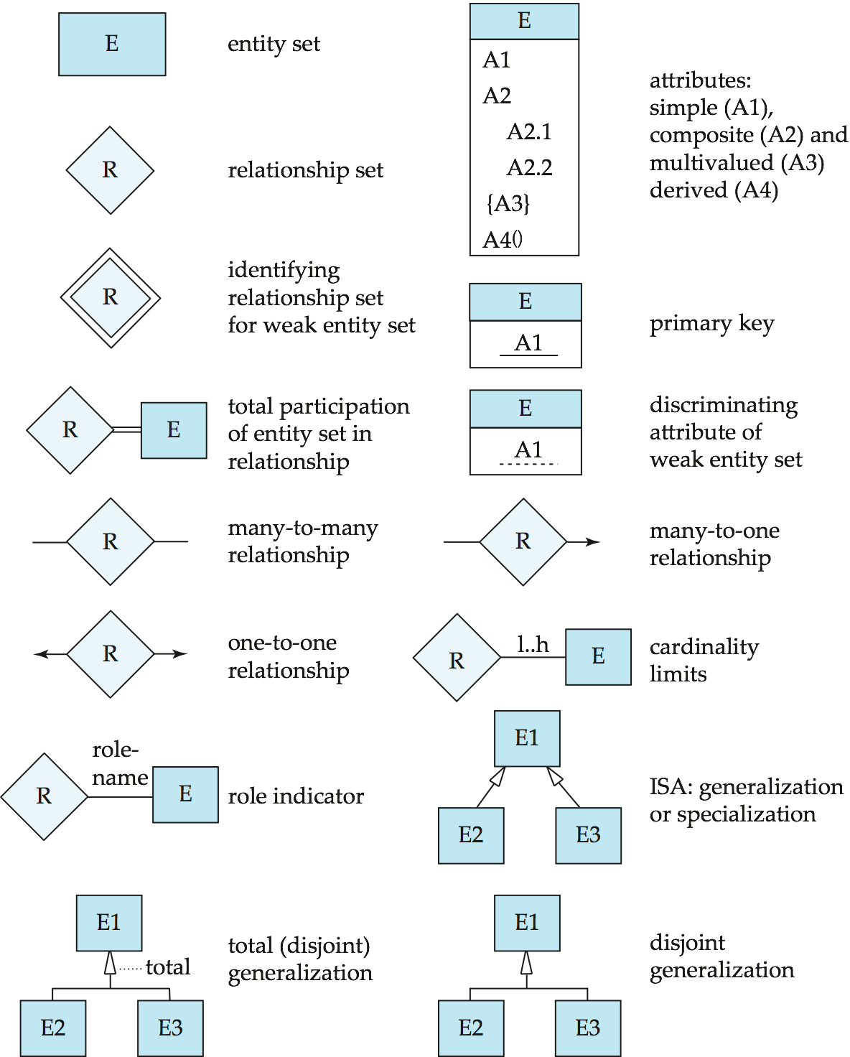
Summary of Symbols Used in E-R Notation

Slide 80
Symbols Used in E-R Notation (Cont.)

Slide 81
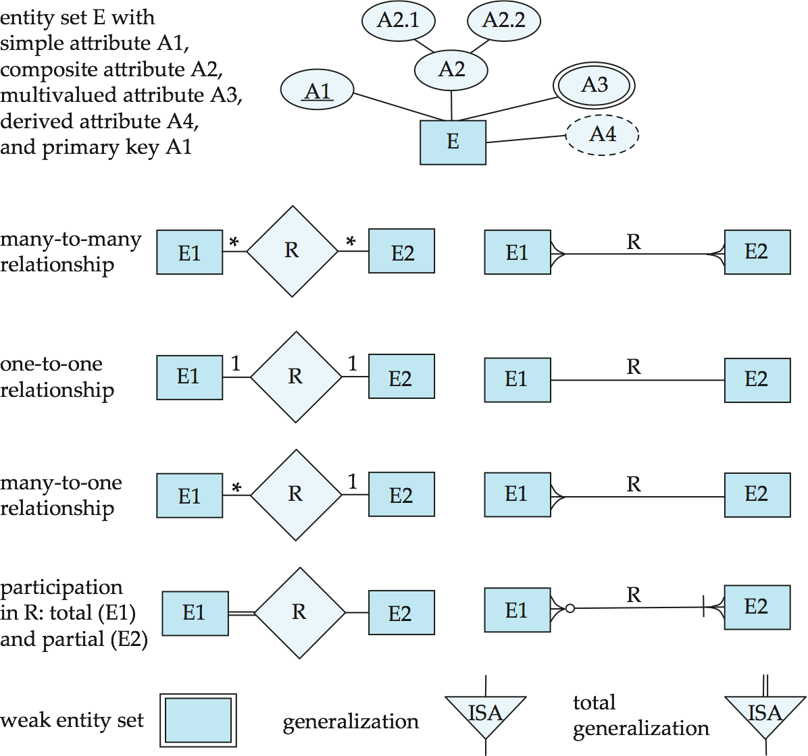
Alternative ER Notations
Chen, IDE1FX, …

Slide 82
Alternative ER Notations
Chen IDE1FX (Crows feet notation)

Slide 83
Example of BCNF Decomposition
R = (A, B, C ) F = {A → B B → C} Key = {A}
R is not in BCNF (B → C but B is not superkey)
Decomposition
R₁ = (B, C)
R₂ = (A,B)

Slide 84
Example of BCNF Decomposition
class (course_id, title, dept_name, credits, sec_id, semester, year, building, room_number, capacity, time_slot_id)
Functional dependencies:
course_id→ title, dept_name, credits
building, room_number→capacity
course_id, sec_id, semester, year→building, room_number, time_slot_id
A candidate key {course_id, sec_id, semester, year}.
BCNF Decomposition:
course_id→ title, dept_name, credits holds
but course_id is not a superkey.
We replace class by:
course(course_id, title, dept_name, credits)
class-1 (course_id, sec_id, semester, year, building, room_number, capacity, time_slot_id)

Slide 85
BCNF Decomposition (Cont.)
course is in BCNF
How do we know this?
building, room_number→capacity holds on class-1
but {building, room_number} is not a superkey for class-1.
We replace class-1 by:
classroom (building, room_number, capacity)
section (course_id, sec_id, semester, year, building, room_number, time_slot_id)
classroom and section are in BCNF.

Slide 86
BCNF and Dependency Preservation
It is not always possible to get a BCNF decomposition that is
dependency preserving
R = (J, K, L ) F = {JK → L L → K } Two candidate keys = JK and JL
R is not in BCNF
Any decomposition of R will fail to preserve
JK → L
This implies that testing for JK → L requires a join

Slide 87
Goals of Normalization
Let R be a relation scheme with a set F of functional dependencies.
Decide whether a relation scheme R is in “good” form.
In the case that a relation scheme R is not in “good” form, decompose it into a set of relation scheme {R₁, R₂, ..., R_{n}} such that
each relation scheme is in good form
the decomposition is a lossless-join decomposition
Preferably, the decomposition should be dependency preserving.

Slide 88
Functional-Dependency Theory
We now consider the formal theory that tells us which functional dependencies are implied logically by a given set of functional dependencies.
We then develop algorithms to generate lossless decompositions into BCNF and 3NF
We then develop algorithms to test if a decomposition is dependency-preserving

Slide 89
Functional Dependencies
Constraints on the set of legal relations.
Require that the value for a certain set of attributes determines uniquely the value for another set of attributes.
A functional dependency is a generalization of the notion of a key.

Slide 90
Closure of a Set of Functional Dependencies
Given a set F set of functional dependencies, there are certain other functional dependencies that are logically implied by F.
For e.g.: If A → B and B → C, then we can infer that A → C
The set of all functional dependencies logically implied by F is the closure of F.
We denote the closure of F by F⁺.

Slide 91
Closure of a Set of Functional Dependencies
We can find F^{+,} the closure of F, by repeatedly applying Armstrong’s Axioms:
if β ⊆ α, then α → β (reflexivity)
if α → β, then γ α → γ β (augmentation)
if α → β, and β → γ, then α → γ (transitivity)
These rules are
sound (generate only functional dependencies that actually hold), and
complete (generate all functional dependencies that hold).

Slide 92
Example
R = (A, B, C, G, H, I) F = { A → B A → C CG → H CG → I B → H}
some members of F⁺
A → H
by transitivity from A → B and B → H
AG → I
by augmenting A → C with G, to get AG → CG and then transitivity with CG → I
CG → HI
by augmenting CG → I to infer CG → CGI,
and augmenting of CG → H to infer CGI → HI,
and then transitivity

Slide 93
Procedure for Computing F⁺
To compute the closure of a set of functional dependencies F:
F ⁺ = F repeat for each functional dependency f in F⁺ apply reflexivity and augmentation rules on f add the resulting functional dependencies to F ⁺ for each pair of functional dependencies f₁and f₂ in F ⁺ if f₁ and f₂ can be combined using transitivity then add the resulting functional dependency to F ⁺ until F ⁺ does not change any further
NOTE: We shall see an alternative procedure for this task later

Slide 94
Closure of Functional Dependencies (Cont.)
Additional rules:
If α → β holds and α → γ holds, then α → β γ holds (union)
If α → β γ holds, then α → β holds and α → γ holds (decomposition)
If α → β holds and γ β → δ holds, then α γ → δ holds (pseudotransitivity)
The above rules can be inferred from Armstrong’s axioms.

Slide 95
Closure of Attribute Sets
Given a set of attributes α, define the closure of α under F (denoted by α⁺) as the set of attributes that are functionally determined by α under F
Algorithm to compute α⁺, the closure of α under F
result := α; while (changes to result) do for each β → γ in F do begin if β ⊆ result then result := result ∪ γ end

Slide 96
Example of Attribute Set Closure
R = (A, B, C, G, H, I)
F = {A → B A → C CG → H CG → I B → H}
(AG)⁺
1. result = AG
2. result = ABCG (A → C and A → B)
3. result = ABCGH (CG → H and CG ⊆ AGBC)
4. result = ABCGHI (CG → I and CG ⊆ AGBCH)
Is AG a candidate key?
Is AG a super key?
Does AG → R? == Is (AG)⁺ ⊇ R
Is any subset of AG a superkey?
Does A → R? == Is (A)⁺ ⊇ R
Does G → R? == Is (G)⁺ ⊇ R

Slide 97
Uses of Attribute Closure
There are several uses of the attribute closure algorithm:
Testing for superkey:
To test if α is a superkey, we compute α^{+,} and check if α⁺ contains all attributes of R.
Testing functional dependencies
To check if a functional dependency α → β holds (or, in other words, is in F⁺), just check if β ⊆ α⁺.
That is, we compute α⁺ by using attribute closure, and then check if it contains β.
Is a simple and cheap test, and very useful
Computing closure of F
For each γ ⊆ R, we find the closure γ⁺, and for each S ⊆ γ⁺, we output a functional dependency γ → S.

Slide 98
BCNF and Dependency Preservation
If it is sufficient to test only functional dependencies on each individual relation of a decomposition in order to ensure that all functional dependencies hold, then that decomposition is dependency preserving.
Because it is not always possible to achieve both BCNF and dependency preservation, we consider a weaker normal form, known as third normal form.

Slide 99
Third Normal Form: Motivation
There are some situations where
BCNF is not dependency preserving, and
efficient checking for FD violation on updates is important
Solution: define a weaker normal form, called Third Normal Form (3NF)
Allows some redundancy (with resultant problems; we will see examples later)
But functional dependencies can be checked on individual relations without computing a join.
There is always a lossless-join, dependency-preserving decomposition into 3NF.

Slide 100
Redundancy in 3NF
There is some redundancy in this schema
Example of problems due to redundancy in 3NF
R = (J, K, L) F = {JK → L, L → K }
J
L
K
j₁
j₂
j₃
null
l₁
l₁
l₁
l₂
k₁
k₁
k₁
k₂
repetition of information (e.g., the relationship l₁, k₁)
(i_ID, dept_name)
need to use null values (e.g., to represent the relationship l₂, k₂ where there is no corresponding value for J).
(i_ID, dept_nameI) if there is no separate relation mapping instructors to departments

Slide 101
Testing for 3NF
Optimization: Need to check only FDs in F, need not check all FDs in F⁺.
Use attribute closure to check for each dependency α → β, if α is a superkey.
If α is not a superkey, we have to verify if each attribute in β is contained in a candidate key of R
this test is rather more expensive, since it involve finding candidate keys
testing for 3NF has been shown to be NP-hard
Interestingly, decomposition into third normal form (described shortly) can be done in polynomial time

Slide 102
Testing for Dependency Preservation
To check if a dependency α → β is preserved in a decomposition of R into R₁, R₂, …, R_{n} we apply the following test (with attribute closure done with respect to F)
result = α while (changes to result) do for each R_{i} in the decomposition t = (result ∩ R_{i})⁺ ∩ R_{i} result = result ∪ t
If result contains all attributes in β, then the functional dependency α → β is preserved.
We apply the test on all dependencies in F to check if a decomposition is dependency preserving
This procedure takes polynomial time, instead of the exponential time required to compute F⁺ and (F₁ ∪ F₂ ∪ … ∪ F_{n})⁺

Slide 103
Example
R = (A, B, C ) F = {A → B B → C} Key = {A}
R is not in BCNF
Decomposition R₁ = (A, B), R₂ = (B, C)
R₁ and R₂ in BCNF
Lossless-join decomposition
Dependency preserving

Slide 104
3NF Decomposition Algorithm
Let F_{c} be a canonical cover for F; i := 0; for each functional dependency α → β in F_{c} do if none of the schemas R_{j}, 1 ≤ j ≤ i contains α β then begin i := i + 1; R_{i} := α β end if none of the schemas R_{j}, 1 ≤ j ≤ i contains a candidate key for R then begin i := i + 1; R_{i} := any candidate key for R; end /* Optionally, remove redundant relations */
repeat if any schema R_{j} is contained in another schema R_{k} then /* delete R_{j} */ R_{j} = R;; i=i-1; return (R₁, R₂, ..., R_{i})

Slide 105
3NF Decomposition Algorithm (Cont.)
Above algorithm ensures:
each relation schema R_{i} is in 3NF
decomposition is dependency preserving and lossless-join
Proof of correctness is at end of this presentation (click here)

Slide 106
3NF Decomposition: An Example
Relation schema:
cust_banker_branch = (customer_id, employee_id, branch_name, type )
The functional dependencies for this relation schema are:
customer_id, employee_id → branch_name, type
employee_id → branch_name
customer_id, branch_name → employee_id
We first compute a canonical cover
branch_name is extraneous in the r.h.s. of the 1st dependency
No other attribute is extraneous, so we get F_{C} =
customer_id, employee_id → type employee_id → branch_name customer_id, branch_name → employee_id

Slide 107
3NF Decompsition Example (Cont.)
The for loop generates following 3NF schema:
(customer_id, employee_id, type )
(employee_id, branch_name)
(customer_id, branch_name, employee_id)
Observe that (customer_id, employee_id, type ) contains a candidate key of the original schema, so no further relation schema needs be added
At end of for loop, detect and delete schemas, such as (employee_id, branch_name), which are subsets of other schemas
result will not depend on the order in which FDs are considered
The resultant simplified 3NF schema is:
(customer_id, employee_id, type)
(customer_id, branch_name, employee_id)

Slide 108
Comparison of BCNF and 3NF
It is always possible to decompose a relation into a set of relations that are in 3NF such that:
the decomposition is lossless
the dependencies are preserved
It is always possible to decompose a relation into a set of relations that are in BCNF such that:
the decomposition is lossless
it may not be possible to preserve dependencies.

Slide 109
Deadlock prevention (Cont.)
Both in wait-die and in wound-wait schemes, a rolled back transactions is restarted with its original timestamp. Older transactions thus have precedence over newer ones, and starvation is hence avoided.
Timeout-Based Schemes:
a transaction waits for a lock only for a specified amount of time. If the lock has not been granted within that time, the transaction is rolled back and restarted,
Thus, deadlocks are not possible
simple to implement; but starvation is possible. Also difficult to determine good value of the timeout interval.

Slide 110
Deadlock Detection
Deadlocks can be described as a wait-for graph, which consists of a pair G = (V,E),
V is a set of vertices (all the transactions in the system)
E is a set of edges; each element is an ordered pair T_{i} →T_{j}.
If T_{i} → T_{j} is in E, then there is a directed edge from T_{i} to T_{j}, implying that T_{i} is waiting for T_{j} to release a data item.
When T_{i} requests a data item currently being held by T_{j}, then the edge T_{i} → T_{j} is inserted in the wait-for graph. This edge is removed only when T_{j} is no longer holding a data item needed by T_{i}.
The system is in a deadlock state if and only if the wait-for graph has a cycle. Must invoke a deadlock-detection algorithm periodically to look for cycles.

Slide 111
Deadlock Detection (Cont.)
Wait-for graph without a cycle
Wait-for graph with a cycle

Slide 112
Deadlock Recovery
When deadlock is detected :
Some transaction will have to rolled back (made a victim) to break deadlock. Select that transaction as victim that will incur minimum cost.
Rollback -- determine how far to roll back transaction
Total rollback: Abort the transaction and then restart it.
More effective to roll back transaction only as far as necessary to break deadlock.
Starvation happens if same transaction is always chosen as victim. Include the number of rollbacks in the cost factor to avoid starvation

Slide 113
Multiple Granularity
Allow data items to be of various sizes and define a hierarchy of data granularities, where the small granularities are nested within larger ones
Can be represented graphically as a tree.
When a transaction locks a node in the tree explicitly, it implicitly locks all the node's descendents in the same mode.
Granularity of locking (level in tree where locking is done):
fine granularity (lower in tree): high concurrency, high locking overhead
coarse granularity (higher in tree): low locking overhead, low concurrency

Slide 114
Example of Granularity Hierarchy
The levels, starting from the coarsest (top) level are
database
area
file
record

Slide 115
Intention Lock Modes
In addition to S and X lock modes, there are three additional lock modes with multiple granularity:
intention-shared (IS): indicates explicit locking at a lower level of the tree but only with shared locks.
intention-exclusive (IX): indicates explicit locking at a lower level with exclusive or shared locks
shared and intention-exclusive (SIX): the subtree rooted by that node is locked explicitly in shared mode and explicit locking is being done at a lower level with exclusive-mode locks.
intention locks allow a higher level node to be locked in S or X mode without having to check all descendent nodes.

Slide 116
Compatibility Matrix with Intention Lock Modes
The compatibility matrix for all lock modes is:

Slide 117
Multiple Granularity Locking Scheme
Transaction T_{i} can lock a node Q, using the following rules:
The lock compatibility matrix must be observed.
The root of the tree must be locked first, and may be locked in any mode.
A node Q can be locked by T_{i} in S or IS mode only if the parent of Q is currently locked by T_{i} in either IX or IS mode.
A node Q can be locked by T_{i} in X, SIX, or IX mode only if the parent of Q is currently locked by T_{i} in either IX or SIX mode.
T_{i} can lock a node only if it has not previously unlocked any node (that is, T_{i} is two-phase).
T_{i} can unlock a node Q only if none of the children of Q are currently locked by T_{i}.
Observe that locks are acquired in root-to-leaf order, whereas they are released in leaf-to-root order.
Lock granularity escalation: in case there are too many locks at a particular level, switch to higher granularity S or X lock

Slide 118
Timestamp-Based Protocols
Each transaction is issued a timestamp when it enters the system. If an old transaction T_{i} has time-stamp TS(T_{i}), a new transaction T_{j} is assigned time-stamp TS(T_{j}) such that TS(T_{i}) <TS(T_{j}).
The protocol manages concurrent execution such that the time-stamps determine the serializability order.
In order to assure such behavior, the protocol maintains for each data Q two timestamp values:
W-timestamp(Q) is the largest time-stamp of any transaction that executed write(Q) successfully.
R-timestamp(Q) is the largest time-stamp of any transaction that executed read(Q) successfully.

Slide 119
Timestamp-Based Protocols (Cont.)
The timestamp ordering protocol ensures that any conflicting read and write operations are executed in timestamp order.
Suppose a transaction T_{i} issues a read(Q)
If TS(T_{i}) ≤ W-timestamp(Q), then T_{i} needs to read a value of Q that was already overwritten.
Hence, the read operation is rejected, and T_{i} is rolled back.
If TS(T_{i}) ≥ W-timestamp(Q), then the read operation is executed, and R-timestamp(Q) is set to max(R-timestamp(Q), TS(T_{i})).

Slide 120
Timestamp-Based Protocols (Cont.)
Suppose that transaction T_{i} issues write(Q).
If TS(T_{i}) < R-timestamp(Q), then the value of Q that T_{i} is producing was needed previously, and the system assumed that that value would never be produced.
Hence, the write operation is rejected, and T_{i} is rolled back.
If TS(T_{i}) < W-timestamp(Q), then T_{i} is attempting to write an obsolete value of Q.
Hence, this write operation is rejected, and T_{i} is rolled back.
Otherwise, the write operation is executed, and W-timestamp(Q) is set to TS(T_{i}).

Slide 121
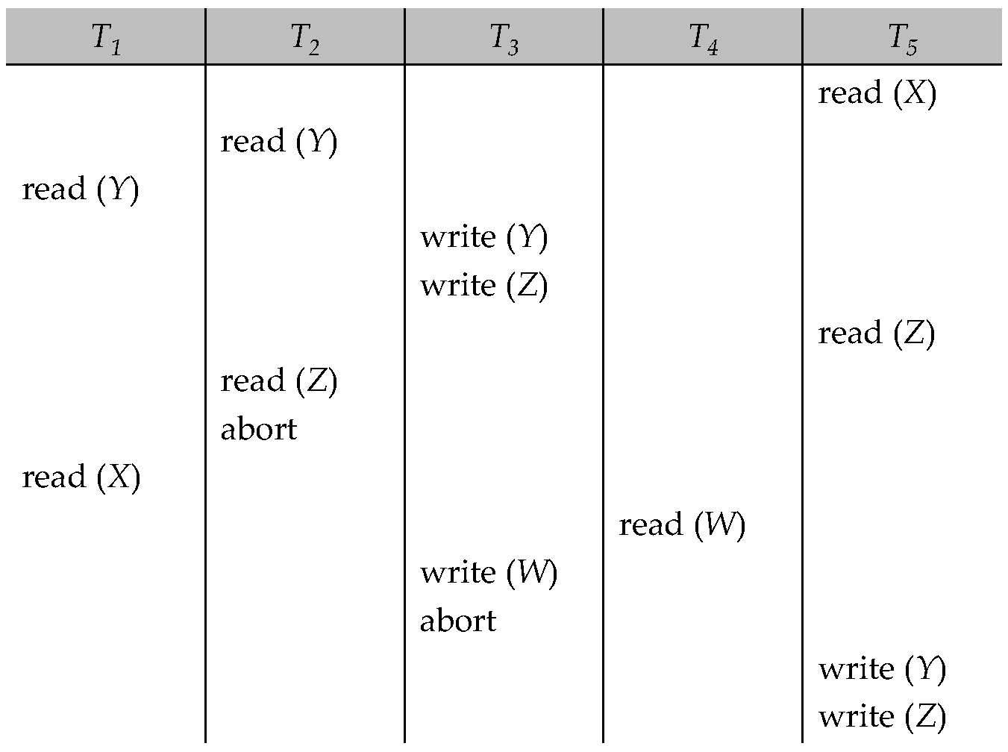
Example Use of the Protocol
A partial schedule for several data items for transactions with
timestamps 1, 2, 3, 4, 5

Slide 122
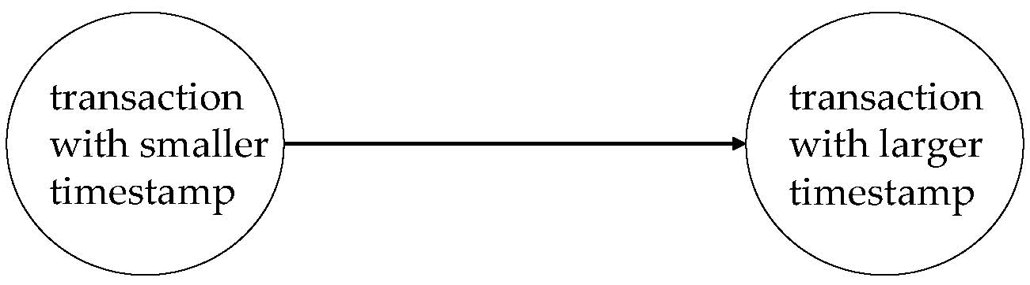
Correctness of Timestamp-Ordering Protocol
The timestamp-ordering protocol guarantees serializability since all the arcs in the precedence graph are of the form:
Thus, there will be no cycles in the precedence graph
Timestamp protocol ensures freedom from deadlock as no transaction ever waits.
But the schedule may not be cascade-free, and may not even be recoverable.

Slide 123
Recoverability and Cascade Freedom
Problem with timestamp-ordering protocol:
Suppose T_{i} aborts, but T_{j} has read a data item written by T_{i}
Then T_{j} must abort; if T_{j} had been allowed to commit earlier, the schedule is not recoverable.
Further, any transaction that has read a data item written by T_{j} must abort
This can lead to cascading rollback --- that is, a chain of rollbacks
Solution 1:
A transaction is structured such that its writes are all performed at the end of its processing
All writes of a transaction form an atomic action; no transaction may execute while a transaction is being written
A transaction that aborts is restarted with a new timestamp
Solution 2: Limited form of locking: wait for data to be committed before reading it
Solution 3: Use commit dependencies to ensure recoverability

Slide 124
Thomas’ Write Rule
Modified version of the timestamp-ordering protocol in which obsolete write operations may be ignored under certain circumstances.
When T_{i} attempts to write data item Q, if TS(T_{i}) < W-timestamp(Q), then T_{i} is attempting to write an obsolete value of {Q}.
Rather than rolling back T_{i} as the timestamp ordering protocol would have done, this {write} operation can be ignored.
Otherwise this protocol is the same as the timestamp ordering protocol.
Thomas' Write Rule allows greater potential concurrency.
Allows some view-serializable schedules that are not conflict-serializable.

Slide 125
Data Access
Physical blocks are those blocks residing on the disk.
Buffer blocks are the blocks residing temporarily in main memory.
Block movements between disk and main memory are initiated through the following two operations:
input(B) transfers the physical block B to main memory.
output(B) transfers the buffer block B to the disk, and replaces the appropriate physical block there.
We assume, for simplicity, that each data item fits in, and is stored inside, a single block.

Slide 126
Example of Data Access
buffer
Buffer Block A
input(A)
X
A
Buffer Block B
Y
B
output(B)
read(X)
write(Y)
x₂
x₁
y₁
work area
of T₁
work area
of T₂
memory
disk

Slide 127
Data Access (Cont.)
Each transaction T_{i} has its private work-area in which local copies of all data items accessed and updated by it are kept.
T_{i}'s local copy of a data item X is called x_{i}.
Transferring data items between system buffer blocks and its private work-area done by:
read(X) assigns the value of data item X to the local variable x_{i}.
write(X) assigns the value of local variable x_{i} to data item {X} in the buffer block.
Note: output(B_{X}) need not immediately follow write(X). System can perform the output operation when it deems fit.
Transactions
Must perform read(X) before accessing X for the first time (subsequent reads can be from local copy)
write(X) can be executed at any time before the transaction commits

Slide 128
Recovery and Atomicity
To ensure atomicity despite failures, we first output information describing the modifications to stable storage without modifying the database itself.
We study log-based recovery mechanisms in detail
We first present key concepts
And then present the actual recovery algorithm

Slide 129
Concurrency Control and Recovery
With concurrent transactions, all transactions share a single disk buffer and a single log
A buffer block can have data items updated by one or more transactions
We assume that if a transaction T_{i} has modified an item, no other transaction can modify the same item until T_{i} has committed or aborted
i.e. the updates of uncommitted transactions should not be visible to other transactions
Otherwise how to perform undo if T1 updates A, then T2 updates A and commits, and finally T1 has to abort?
Can be ensured by obtaining exclusive locks on updated items and holding the locks till end of transaction (strict two-phase locking)
Log records of different transactions may be interspersed in the log.

